Slide 1
Potato Chip Mailing Contest
Group 1
Miles,Greg,Nathan

Slide 2
Objective/Requirements
We have to build a box/package that we can ship a potato chip in without it breaking.
This box with the chip in it will also be thrown off a 3 level building and must not break the chip as a test before mailing it.

Slide 3
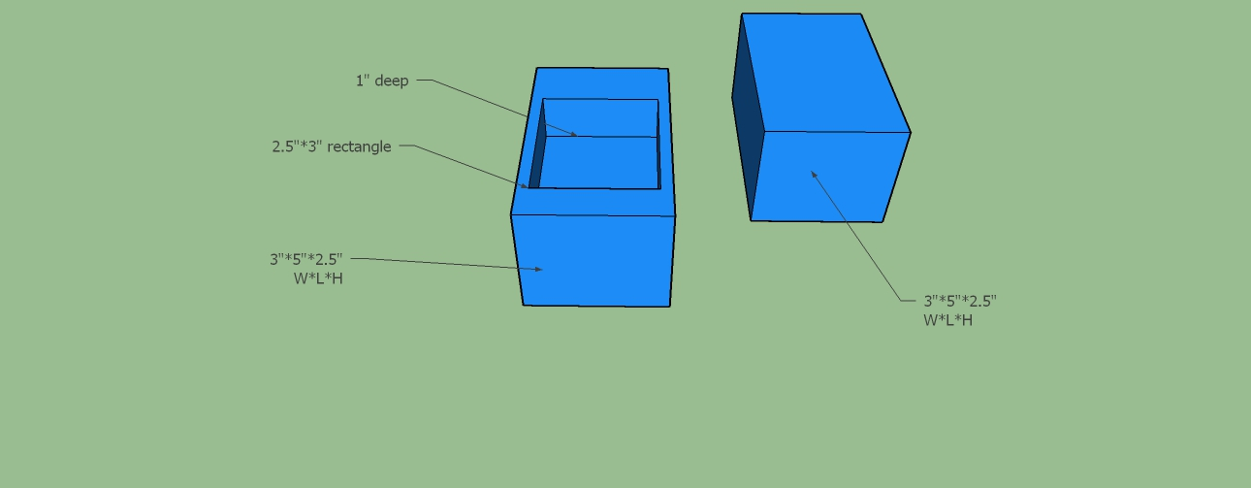
Design

Slide 4
Predicted Score with Explanation
O.54 is are groups predicted score.

Slide 5
Parts List
Tape
Foam
Cardboard
Bubblewrap
Parachute (optional)

Slide 6
Photo of Mailed Container

Slide 7
Data
Official Score

Slide 8
Lessons Learned
What worked well
What would you change next time
If your predicted score differed from your actual, why?

